Slide 1


Improve Call Center Effectiveness Using Machine Learning
Guruprasad Velikadu Krishnamoorthy

Slide 2

Problems Faced by the Call Centers
Handling Frustrated Customers:
When customers call the help desk for support, they are forced to navigate through a series of options to collect the details through the Interactive Voice Response (IVR) systems before talking to the live agent.
As many Call centers operate Overseas, the Customers face difficulties understanding the Foreign accent, making it more Frustrating for both parties.
Staffing Issues:
Employee turnover is much higher in the call center industry compared to others due to demanding workloads, odd hours, and repetitive and fast-paced workstyles
Many Call centers are understaffed which complicates the situation due to increased Employee burnout, and reduced productivity, thus reducing the overall quality of Service.

Slide 3

How can Machine Learning help?
Maintaining a Good balance between Employee Satisfaction and Providing a Better Customer Experience is a major challenge for most call centers.
Though this can be handled by effective training, aiding on the field with real-time suggestions on the screen can help de-escalate the situation and reduce friction, thus improving the overall customer experience.
In this Project Two Convolutional Neural Network models were built.
One analyzes the employees’ sentiment by examining the photos taken during the call using Image Classification algorithms.
The other model investigates the customer’s tone to understand the emotion using Speech emotion recognition algorithms.
By combining the outcome of both models, recommendations will be displayed on the Employee’s screen.

Slide 4
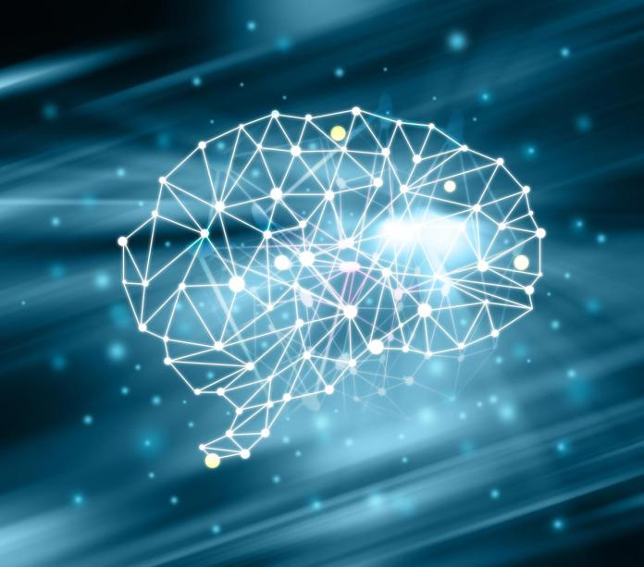
Steps Involved in the Model Building Process
1. Data Collection and Exploration
2. Data Preprocessing and Splitting
3. Model Building and Training
4. Hyperparameter Tuning/ Optimization
5. Evaluating the Model Performance

Slide 5
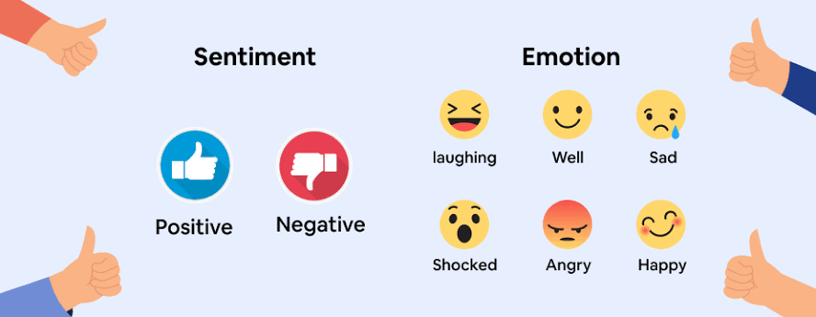
Difference between Emotion & Sentiment Analysis
Though both Sentiment and Emotion may be relatable, they are vastly different and are usually used interchangeably.
Sentiment Analysis often known as “Mining of Opinions” is used to understand the feelings or Opinions about various fields such as Marketing Reviews, Social media, etc. The Outcomes are usually values such as Positive, Negative, and Neutral.
Sometimes the sentiment analysis cannot fully understand the customer’s emotion leading to ineffective customer experience.
In this Project, Sentiment analysis of the employees is performed using Image classification algorithms.
Emotion analysis extends beyond the basic sentiment and can study a variety of human emotions such as Sadness, Happiness, Fear, Disgust, Surprise, etc. This is achieved by studying facial features or Voice signals to understand the feelings expressed.
In this project, Speech Audio data is used to build an Emotion Recognition Model.

Slide 6
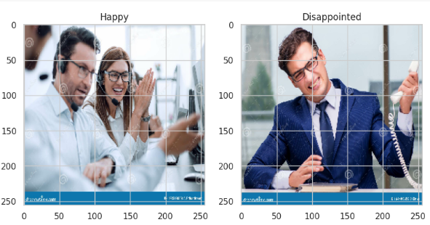
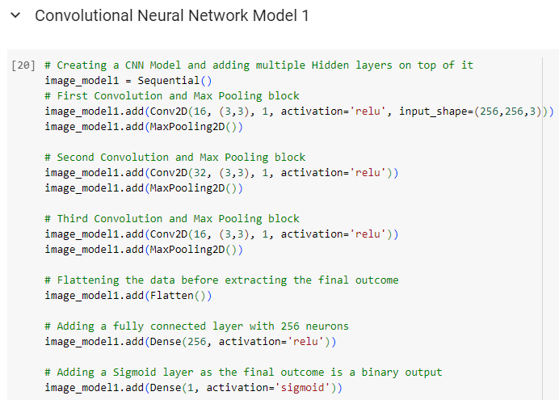
Image Classification for Sentiment Analysis
Data Extraction: 100 Pictures of Happy and Disappointed Call Center Employees were downloaded using the “Bing-image-downloader” package for training the models.
Data Preparation: The images were converted into NumPy arrays using the SkImage Python library. The dataset was split into Train, Validation, and Test sets in the 60, 20 & 20 ratios. All images were resized and rescaled using Standard Scaler.
Model Building & Training: Two Image Classification models were built in this project.
Convolutional Neural Network Model using TensorFlow and Keras:
In this model, 3 layers of Convolution and Max pooling block were added before flattening the data and feeding to the Fully connected or Dense layers. ReLU was used as the activation function in the hidden layers.
As the model produces a Binary Target (Happy Employee / Frustrated Employee), the Sigmoid function was used in the final output layer.
Support Vector Machine Model using Scikit learn package
Hyperparameter tuning was performed by training the model using a Grid of values to find the optimal values for the Model.

Slide 7
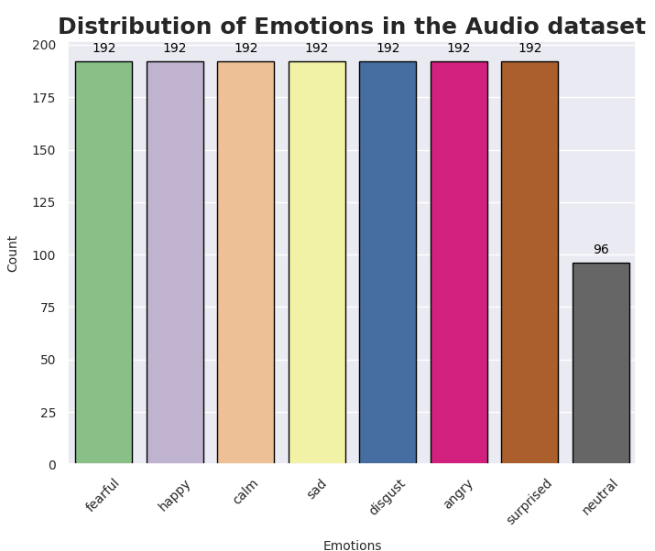
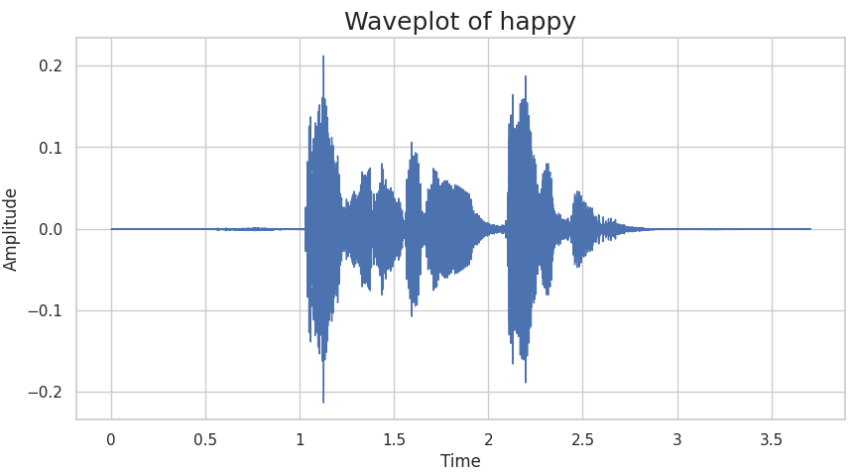
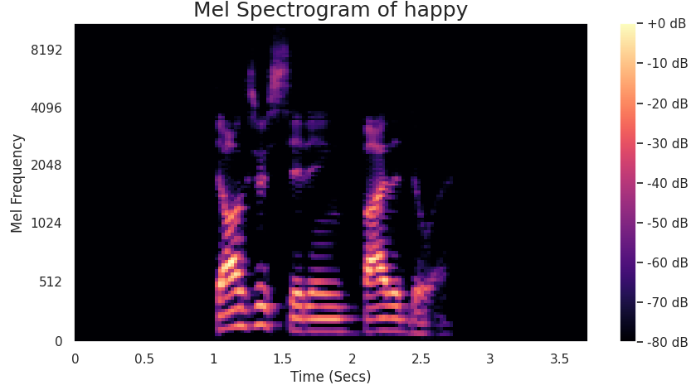
Speech Emotion Recognition
Data Extraction: The RAVDESS dataset was taken from Kaggle which contains 1440 audio files recorded by 12 Male and 12 Female actors displaying emotions such as Fear, pleasant surprise, sadness, Anger, etc. The distribution of data samples in the dataset is shown in a Bar chart
Data Exploration: The Audio files were converted to NumPy arrays using the Librosa Library in Python. The numeric data was validated by plotting Wave plot, Spectrogram, and Mel Spectrogram on a few sample files.
Feature Extraction: Various features such as Zero Crossing Rate, Root Mean Square, Mel-Frequency cepstral coefficients, short-term Fourier transforms of Chroma Variants, Spectral contrast, and Mel-Spectrogram were extracted for each speech file, and the resulting NumPy array of features were flattened and combined.
Data Preparation & Splitting: Further Noise and Pitch were added for each speech file, and the resulting NumPy arrays were combined to be fed to the Machine Learning Model. The combined array was standardized using a standard scaler and label encoded to form the final input to the Machine learning model, before being split into Train and Test sets.

Slide 8
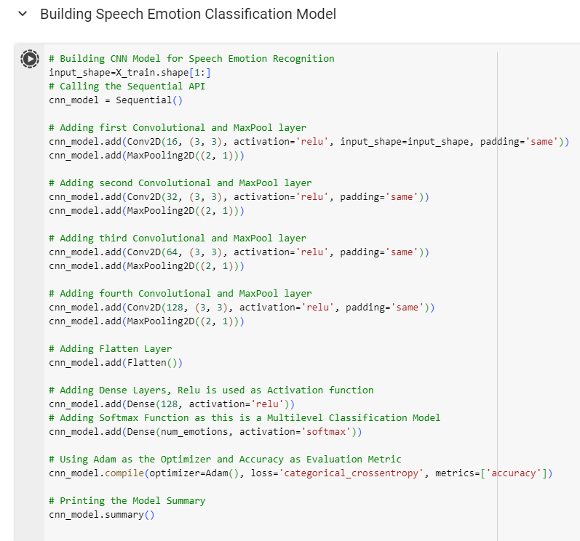
Speech Emotion Recognition- Model Building
A Convolutional Neural Network Model was built using TensorFlow, which uses Keras Sequential API.
Like the Image classification model, several Hidden layers were added to the Neural Network using Conv2D and MaxPooling2D.
The Rectified Linear Activation function, commonly known as "ReLU," was used in the hidden layers.
The “softmax” function was used in the final output layer as an activation function as there were multiple classes in the Target variable.
Adaptive Moment Estimation,(Adam) was used as the optimizer to minimize the loss function during the training of neural networks. Accuracy was used as the evaluation metric.

Slide 9
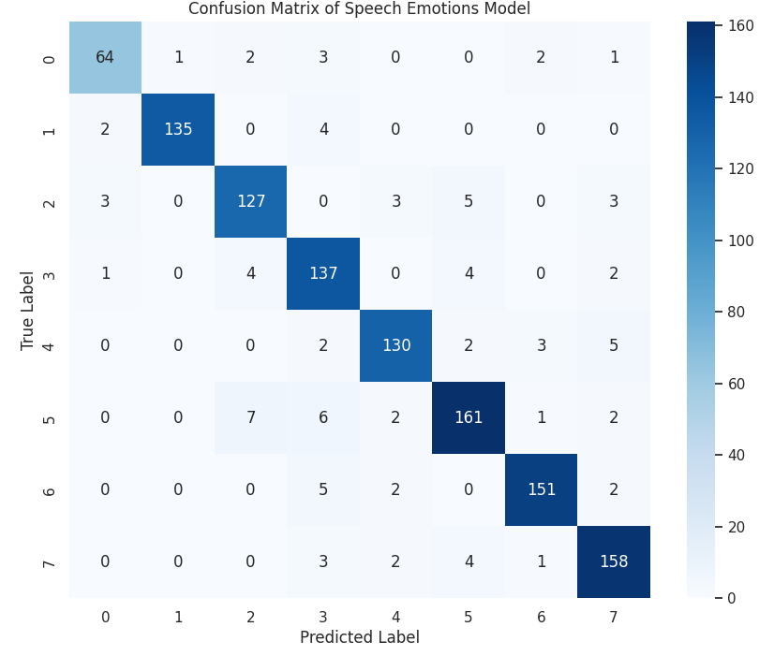
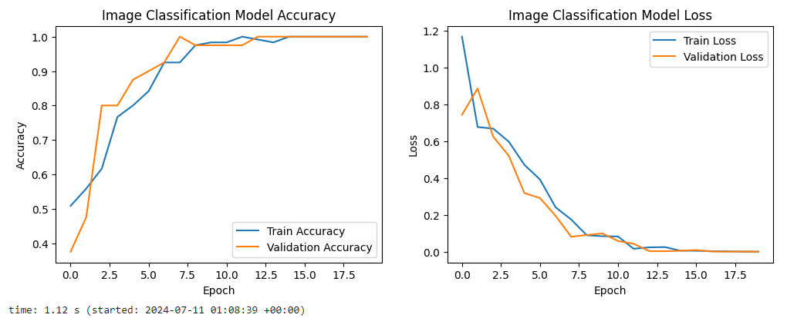
Evaluation & Validation of Model Results
The performances of both Image Classification and the Speech Emotion recognition models were measured by calculating and plotting the Accuracy and Loss functions as shown in the figures.
The Accuracy that represents the percentage of predictions where the predicted value is the same as the actual value, appears to increase as the number of Epochs increases and then starts to flatten.
The Loss, which represents the sum of errors made in each sample, decreases as the number of epochs increases.
The Confusion Matrix commonly used to describe the Classification model performance suggests that the Speech emotion model predicted most values correctly.
The Model results were validated by extracting the text from the Audio files and a BERT NLP model was used for Validating the Text sentiment.

Slide 10
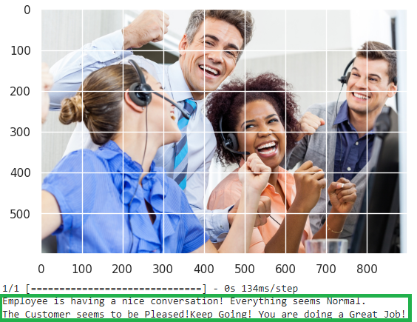
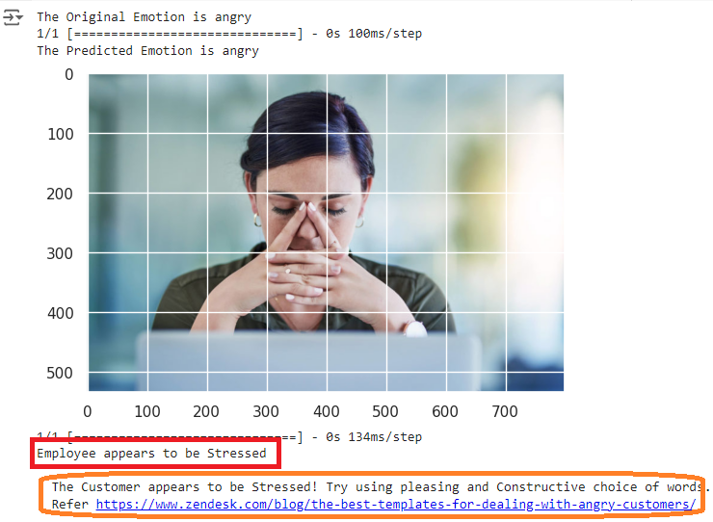
Sample outcomes of the Model
Based on the combined results of both the Image and Emotion recognition model, further recommendations were provided.
If both the Employee and the customer appear to be stressed, the model will provide additional resources or suggestions to calm the situation. It will also prompt if the employee needs additional assistance.
If everything appears normal, the model will prompt a message stating the same.

Slide 11

Implementation Plan & Recommendations
Implementation:
To test the model, an app using Streamlit or a Web User interface can be built to take both the Speech and Image inputs and make predictions.
The model must be invoked for small intervals, such as every 15 seconds of the call, and compare the results with the previous outcomes before making the final recommendations, thus avoiding False positives.
Recommendations:
The model was trained based on the data available on the web. However, it is recommended that the model be further trained using the real-world data acquired from the call centers.
The model can be expanded further by extracting the Audio, converting it to text, and analyzing the emotions from the text. This can primarily supplement the sentiment analysis the project is trying to achieve.

Slide 12

Challenges & Ethical Concerns
Challenges:
The datasets used for Training the models contained the voices of professionally trained actors expressing their emotions. However, in the real world, people's emotions may not be as clear as in the training dataset.
The models were trained using audio files that were only a few seconds long. The calls usually last for a few minutes or longer. This can be particularly challenging for the model to predict accurate outcomes if there are a variety of emotions during the duration of the call.
Ethical Concerns:
Though the project only intends to capture the employees' facial expressions to analyze their moods, it may be mistaken for an employee monitoring tool. Hence, it is essential to be transparent to the employees about the tool's purpose to avoid confusion
The model was trained using the voices recorded by actors speaking North American English accent. This may raise ethical concerns for non-English speakers, such as customers who prefer to speak Spanish.
There may be privacy concerns about the pictures of the employees being taken. Hence, getting legal counsel and not violating local laws is necessary
Notes:
picture for processing, it may rise privacy concerns, so it is a good idea to get legal counsel to avoid conflicts with local laws.

Slide 13
References
https://roicallcentersolutions.com/blog/common-call-center-staffing-problems-avoid-them/#:~:text=Inadequate%20training%20not%20only%20leads
https://www.activtrak.com/solutions/employee-monitoring/ethical-considerations/#:~:text=Be%20transparent%3A%20When%20it%20comes
https://www.zendesk.com/blog/the-best-templates-for-dealing-with-angry-customers/
https://www.onvego.com/post/top-9-reasons-why-customers-hate-ivr
https://stagezero.ai/blog/sentiment-analysis-emotion-ai/#:~:text=Sentiment%20analysis%20focuses%20on%20the,subjective%20aspects%20of%20human%20communication.

Slide 14

Thank you

